Slide 1
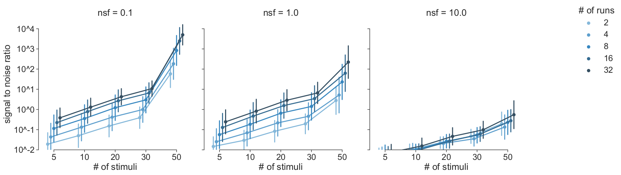

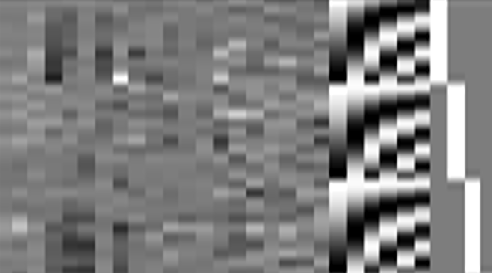

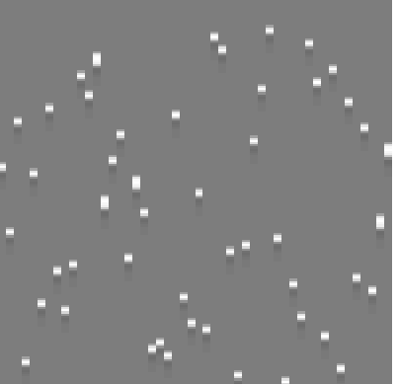
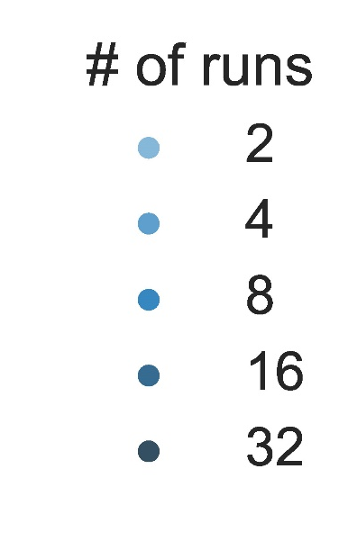
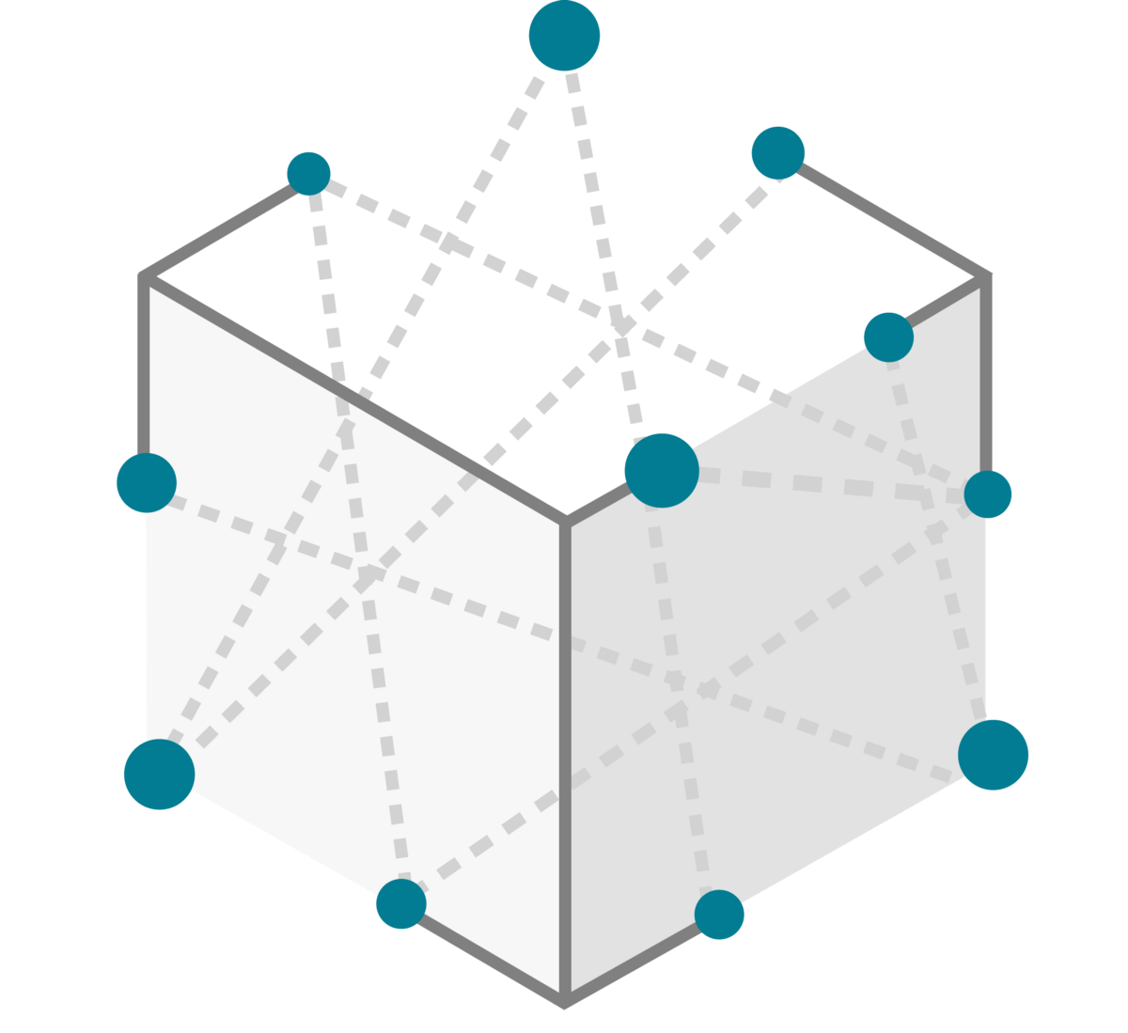

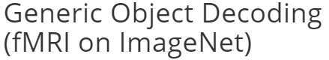
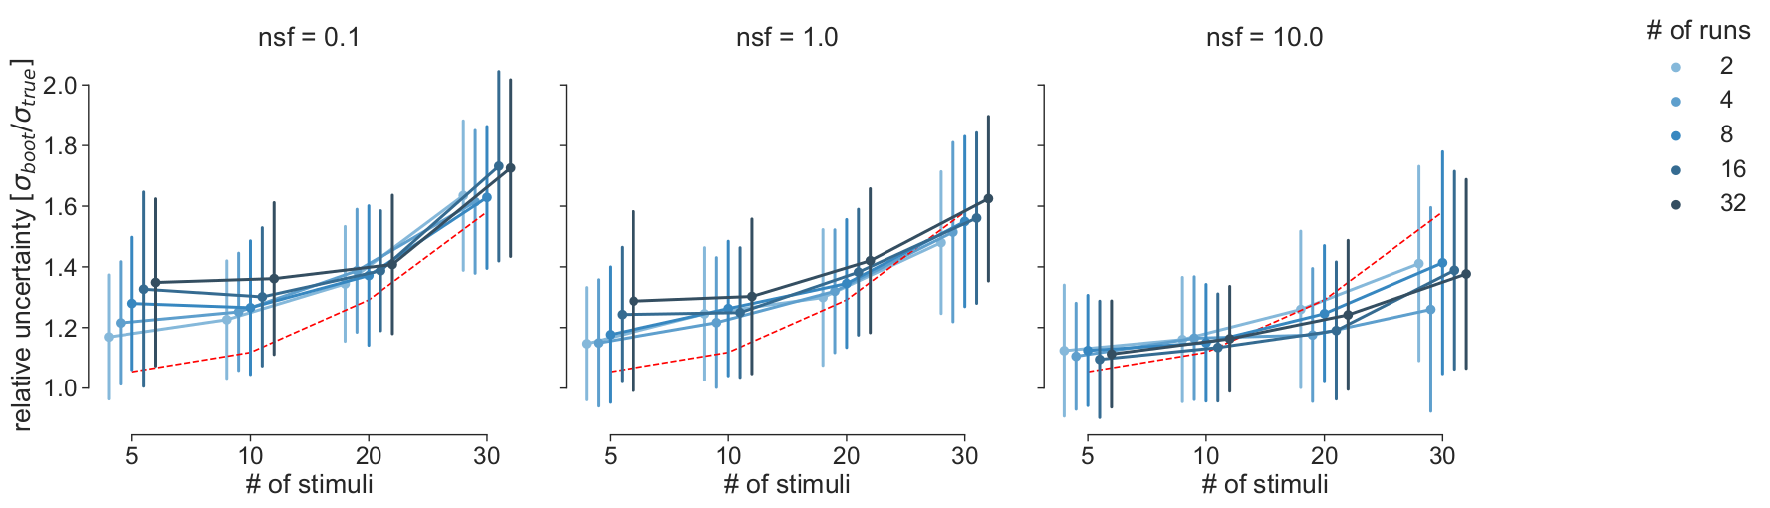

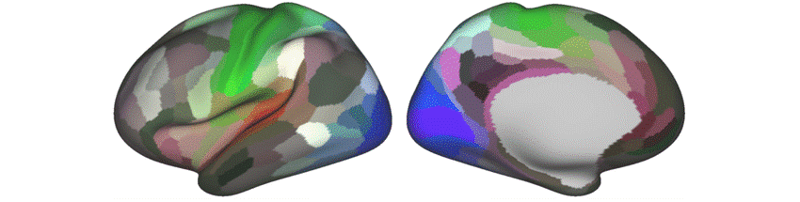

A
Open source fMRI data
B
L1 GLM: Denoise
C
L2 GLM & Noise Simulation
E
Results: Runs vs. Stimuli
Noise regressor design matrix
Stimuli design matrix
fMRI Prep
HRF
NSF
Permute
residuals
D
*
*
π
AR(2)
model
RDM Generation & Inference
Subset data & compute RDMs
Data RDMs
Mask
ROIs
1000x bootstrap over patterns
L2-GLM
Cosine similarity
Σ
GT Model
Stimulus
Compute RDMs & pool over subjects
Subject
Channel

